Slide 1
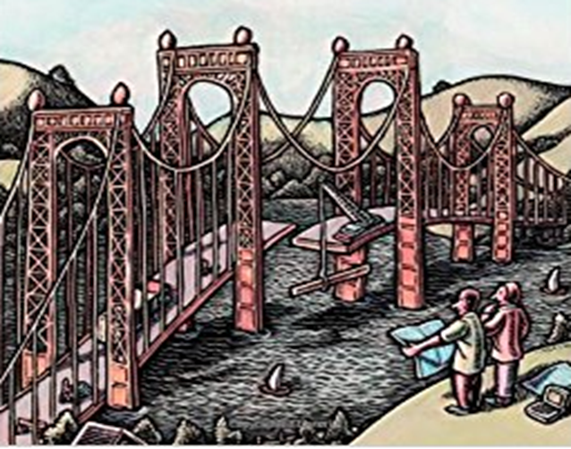
Software Design Principles
GRASP: Object Oriented Design Patterns

Slide 2
Design Principles
If we need to build object oriented systems which are maintainable, extensible and modular, it would be best done using well known principles and practices as part of the OO design.
These address problems or potential issues which developers will face and provide some principles or approaches to address the same or patterns which can be used to get over the same.
These techniques have not been invented to create new ways of working, but to better document and standardize old, tried-and-tested programming principles in object-oriented design.

Slide 3
Design Principles
GRASP
stands for
General Responsibility Assignment Software Principles(or Patterns)
These are patterns and/or principles which help guide assigning responsibilities to collaborating classes objects.
These principles serve as guidelines to arrive at a better class design.

Slide 4
What is Responsibility
is a contract / obligation that a class / module / component must accomplish
Responsibility can be:
accomplished by a single object
or a group of object collaboratively accomplish a responsibility.
GRASP helps us in deciding which responsibility should be assigned to which object/class.
Identify the objects and responsibilities from the problem domain, and also identify how objects interact with each other.
Define blue print for those objects – i.e. class with methods implementing those responsibilities.
4

Slide 5
Responsibility
Design holds the responsibility of knowing the data & associated data and the actions or behaviours associated with data
Knowing in terms of its
Private state
Computed state
Expected Behaviour in terms
Send messages by itself and modifying its private state
Instantiate another object
Send messages to another object
4

Slide 6
Responsibility knowing and Doing
This involves design supporting the “doing” responsibilities
Doing something itself, such as creation an object or doing a calculation.
Initiating action in other objects
Controlling and coordinating activities in other objects.
This involves the design supporting the “knowing” responsibilities
Knowing about encapsulated data
Knowing about related objects.
Knowing about things it can derive or calculate
5

Slide 7
GRASP Design Principles
GRASP Principles (9 of them)
Creator
Information Expert
Low Coupling
Controller
High Cohesion
Indirection
Polymorphism
Protected Variations
Pure Fabrication

Slide 8
1. Creator Principles
Who creates an Object? Or who should create a new instance of some class?
“Container” object creates “contained” objects.
Decide who can be creator based on the objects association and their interaction.

Slide 9
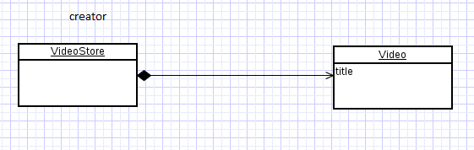
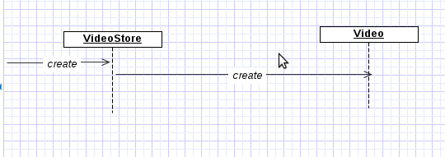
Creator Example
Consider VideoStore and Video in that store.
VideoStore has an aggregation association with Video. i.e VideoStore is the container and the Video is the contained object.
So, we can instantiate video object in a VideoStore class
Class Relation
Sequence

Slide 10
Information Expert
Given an object O, which of the responsibilities can be assigned to O?
Expert principle says – assign those responsibilities to a class which has the information to fulfill that responsibility.
They have all the information needed to perform operations, or in some cases they collaborate with others to fulfill their responsibilities.
Notes:
Catalog …

Slide 11
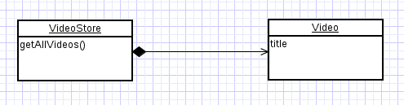
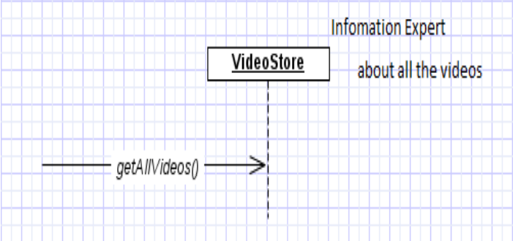
Information Expert Example
Assume we need to get all the videos of a VideoStore.
Since VideoStore knows about all the videos (catalog), we can assign this responsibility of giving all the videos can be assigned to VideoStore class.
VideoStore is the information expert.
Class Relation
Sequence
Notes:
Catalog …

Slide 12
Low Coupling
How strongly the objects are connected to each other? Coupling – object depending on other object.
When depended upon element changes, it affects the dependant also
Low Coupling – How can we reduce the impact of change in depended upon elements on dependant elements.
Prefer low coupling – assign responsibilities so that coupling remain low.
Minimizes the dependency hence making system maintainable, efficient and code reusable
Two elements are coupled, if – One element has aggregation/composition association with another element. – One element implements/extends other element.

Slide 13
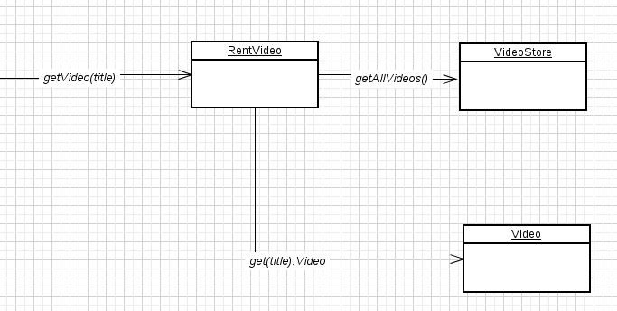
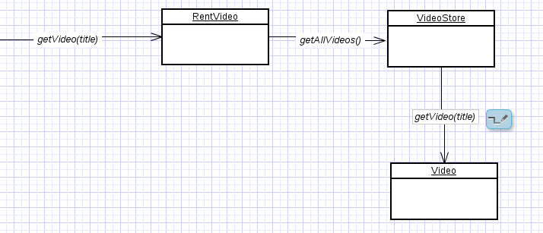
Low Coupling Example
High Coupling
here class RentVideo knows about both VideoStore and Video objects. Rent is depending on both the classes.
VideoStore and Video class are coupled, and Rent is coupled with
VideoStore. Thus providing low coupling.
Lower Coupling

Slide 14
Controller
Deals with how to delegate the request from the UI layer objects to domain layer objects .
Controller helps in minimizing the dependency between GUI components and the system operation classes which represent a set of system level operation
When a request comes from UI layer object, Controller as a pattern helps us in determining what is that first object that should receive the message from the UI layer objects.
This object is called controller object which receives request from UI layer object and then controls/coordinates with other object of the domain layer to fulfill the request.
It delegates the work to other class and coordinates the overall activity.
Benefits
can reuse this controller class.
Can use to maintain the state of the use case.
Can control the sequence of the activities

Slide 15
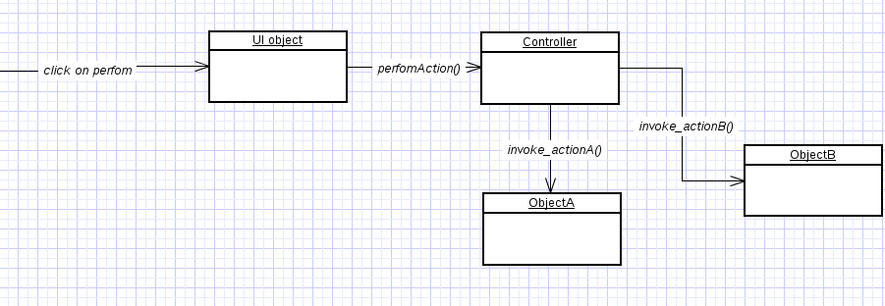
Controller Example

Slide 16
High Cohesion
How are the operations of any element are functionally related?
Related responsibilities into one manageable unit.
Prefer high cohesion
Clearly defines the purpose of the element
Benefits:
Easily understandable and maintainable.
Code reuse
Low coupling

Slide 17
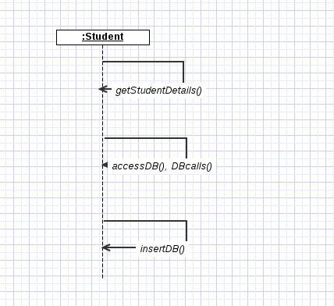
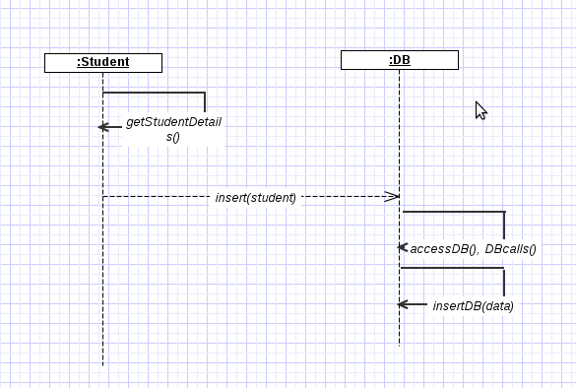
High Cohesion Example
Low Cohesion Higher Cohesion

Slide 18
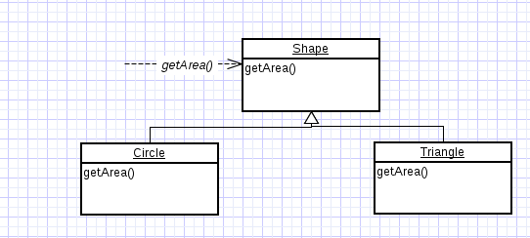
Polymorphism
How to handle related but varying elements based on element type?
Polymorphism guides us in deciding which object is responsible for handling those varying elements.
Benefits: Handling new variations will become easy.
Example:
The getArea() varies by the type of shape, so we assign that responsibility to the subclasses
By sending message to the Shape object, a call will be made to the corresponding sub class object – Circle or Triangle

Slide 19
Pure Fabrication
Use of a pure fabrication class that does not represent a concept in the problem domain, to make up a assigned set of related responsibilities.
Provides a highly cohesive set of activities.
Behavioral decomposed – implements some algorithm.
Examples: Adapter, Strategy design patterns
Benefits: High cohesion, low coupling and can reuse this class
Eg.
Suppose we have a class for Shape and if we must store the shape data in a database.
If we put this responsibility in Shape class, there will be many database related operations thus making Shape incohesive.
So, create a fabricated class DBStore which is responsible to perform all database operations.
Eg. logInterface which is responsible for logging information is also a good example for Pure Fabrication.

Slide 20
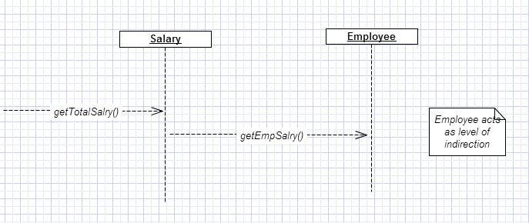
Indirection
How can we avoid a direct coupling between two or more elements.
Indirection introduces an intermediate unit to communicate between the other units, so that the other units are not directly coupled.
Benefits: Low coupling
Design Patterns : Adapter, Façade, Observer
Example : Here polymorphism illustrates indirection
Class Employee provides a level of indirection to other units of the system.

Slide 21
Protected Variation
How to avoid impact of variations of some elements on the other elements.
Achieved by providing a well defined interface so that the there will be no affect on other units and then using polymorphism to create various implementations of this surface
Provides flexibility and protection from variations.
Provides more structured design.
Example: Interfaces-polymorphism
Usage
Problem: How to design objects, subsystems, and systems so that the variations or instability in these elements does not have an undesirable impact on other elements? Solution: Identify points of predicted variation or instability; assign responsibilities to create a stable interface around them.

